Slide 1

Location hunter
Creators: Eetu Mutanen
Rico Pietarinen
Jimi Tuononen

Slide 2
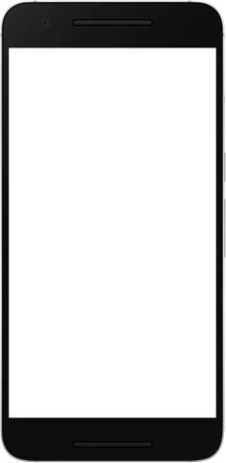
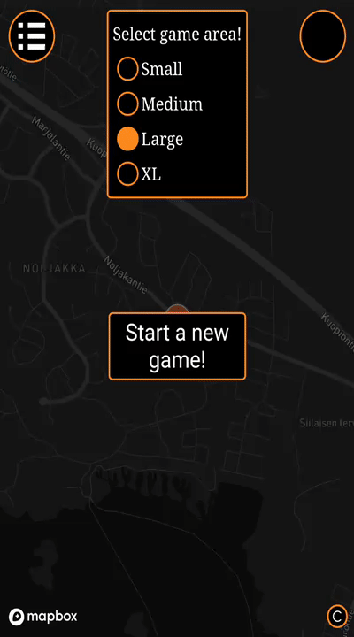
Features
Randomized booster locations
View range boosters
Map size options
Visualization for closest booster
Multiple different sound notifications

Slide 3
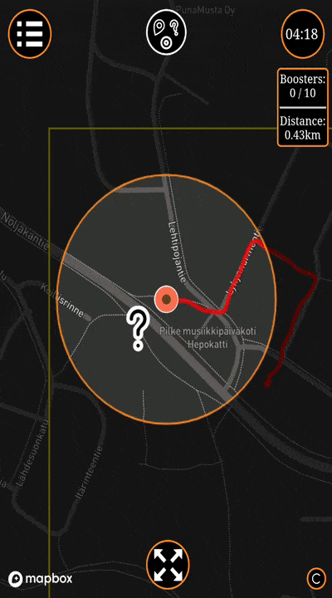
Why our app is the best
Explore surrounding area
Every round is different
You can play it almost anywhere
Exercise motivator

Slide 4
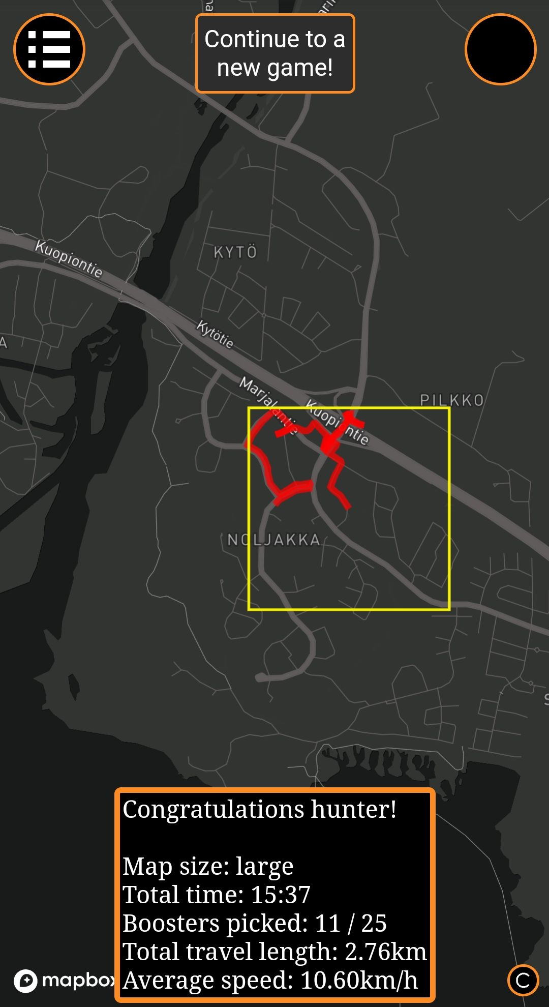
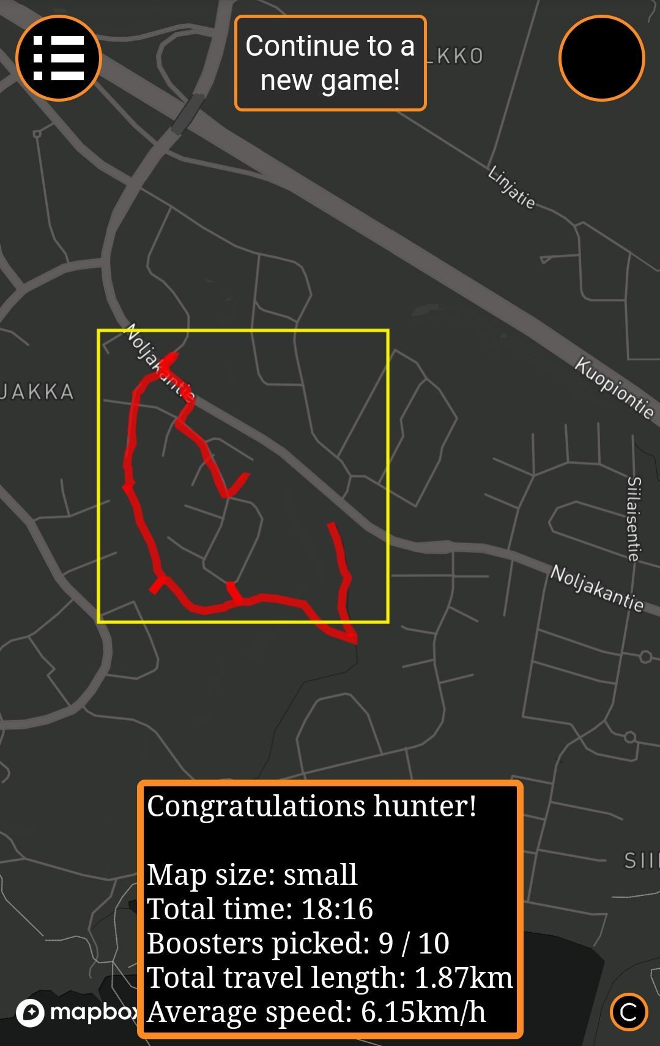
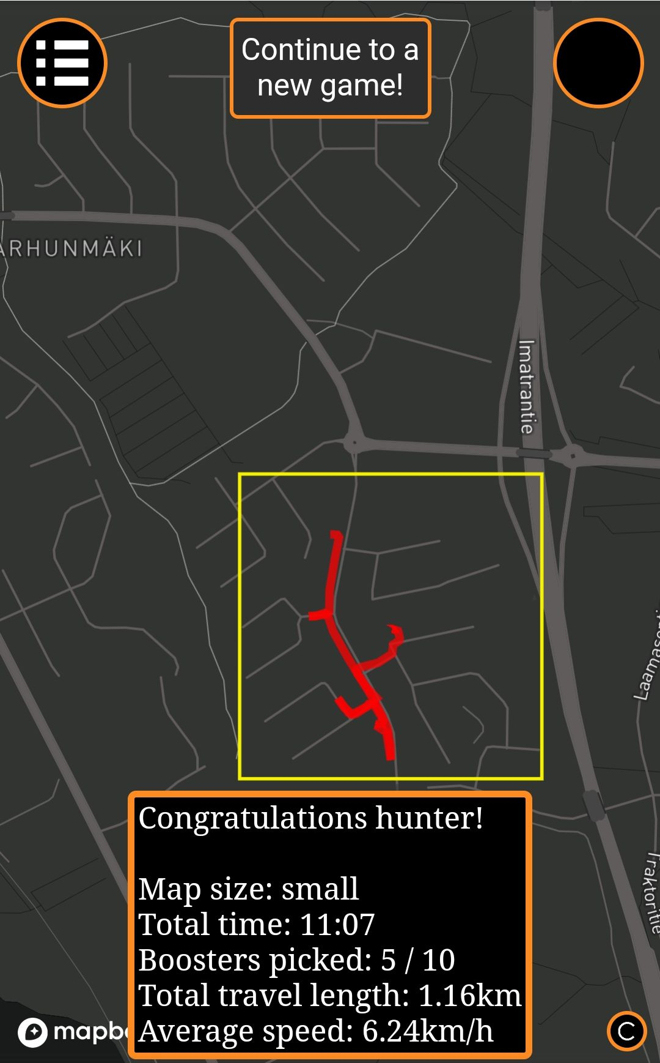
Example game results

Slide 5
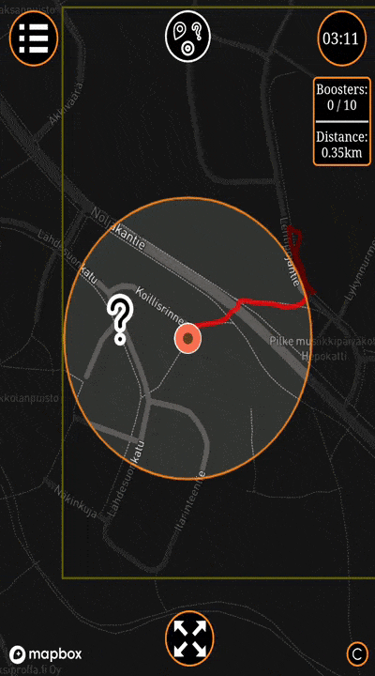
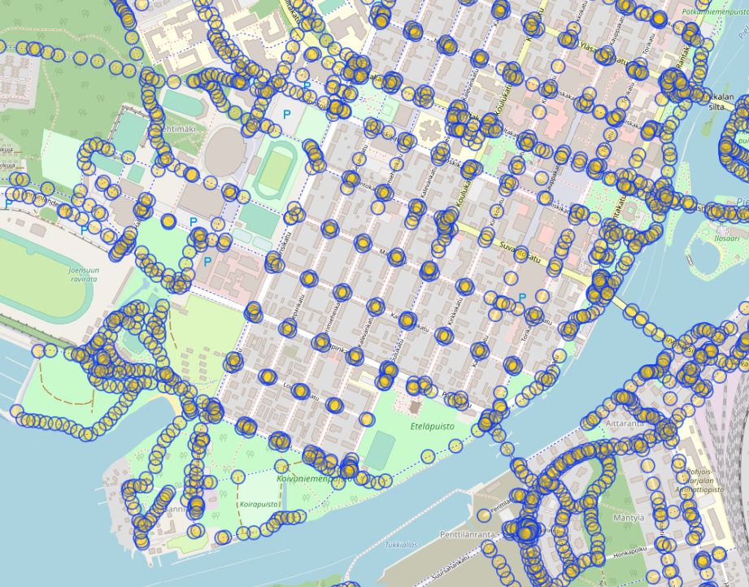
What did we learn?
Mapbox API
Overpass API calls (getting cool data)
JavaScript

Slide 6
THANK YOU!
Contact information:
jimituo@student.uef.fi
eetumut@student.uef.fi
ricop@student.uef.fi
Test here: https://razerpk.github.io/

